Slide 1
KS2 Word of the Week

Slide 2

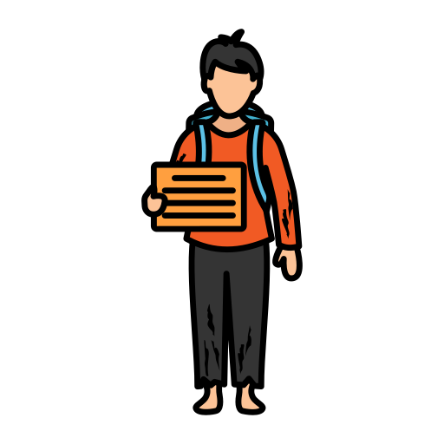
Shinobi Word of the Week
vulnerable
Word Class
Word of the Day:
(adjective)
(vul-ner-a-ble)
Pronunciation / Syllables
Definition:
Someone who is vulnerable is weak and without protection, with the result that they are easily hurt physically or emotionally.
Charlie from the story was vulnerable.
Synonym: | Antonym: | Prefix / Suffix: | Rhyme: | Link Word:
sensitive | safe | in- |  | emotionally
accessible | protected |  |  | remain

Slide 3
Ninja Word Challenge
Impress your teacher and parents with your new word knowledge. See if you can slip this word into your conversations, or your writing this week.

