Slide 1
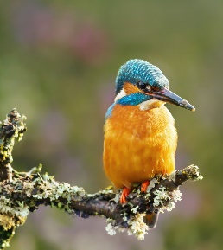
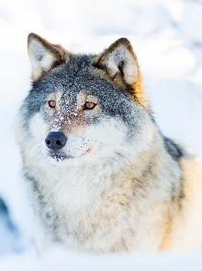

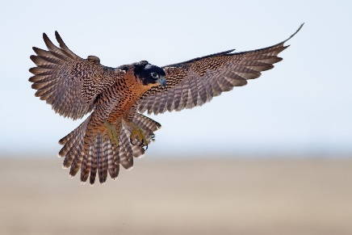
Meet the Teacher
Year 5
Falcons - Miss Roberts, Mrs. Wood and Mr Bravi
Kingfishers – Miss Fray and Mrs Adams
Wolves – Mrs. Willis and Mrs. Barrett, Mrs Stokes

Slide 2
Start and Finish Times
8:35am – gates and classrooms open. (Registration closes at 8:55am)
3:10pm – pick up time.
4:20pm – club finish time.

Slide 3
What we expect in Year 5.
Independence!
Good presentation of work.
To learn/revise times tables and spellings each week.
To read at home regularly.

Slide 4
Curriculum Overview
Term 1:
English – Beowulf by Michael Morpurgo
Maths – Place value and addition and subtraction
Science – Forces
History – Anglo-Saxons
ICT – Coding
P.E – Basketball and Hockey
R.E –
PSHE – What makes up a person’s identity?
D & T - pulleys
Spanish – All About Me

Slide 5
Curriculum Overview
Term 2:
English – How To Train Your Dragon by Cressida Cowell
Maths – Multiplication and Division A and Fractions A
Science – Space
History – Vikings
ICT – Online Safety and Databases
P.E –R.E – Christianity, including Christmas
PSHE – What decisions can people make with money?
Art – Illuminated letters
Spanish – The Way We Look

Slide 6
Curriculum Overview
Term 3:
English – The Jamie Drake Equation by Christopher Edge
Maths – Multiplication and Division B and Fractions B
Science – Properties and Changes of Materials
Geography - Where in the World Are We?
ICT – Spreadsheets
P.E –
R.E –
PSHE – How can we help in an accident or emergency?
Art – The art of Peter Thorpe
Spanish – Eating Out

Slide 7
Curriculum Overview
Term 4:
English – The Nowhere Emporium by Ross Mackenzie
Maths – Decimals and Percentages, Perimeter and Area and Statistics
Science – Animals including Humans and Life Cycles
History – The Indus Valley
ICT – Game Creator
P.E –
R.E – Christianity – The Easter Story
PSHE – How can friends communicate safely?
DT –
Spanish – My World

Slide 8
Curriculum Overview
Term 5:
English – The Last Bear by Hannah Gold
Maths – Shape, Position and Direction and Decimals
Science – Reproduction
Geography – Climate Change
ICT – 3-D Modelling
P.E –
R.E –
PSHE – How can drugs common to everyday life affect health?
Art – The work of Andy Goldsworthy
Spanish – In the Classroom

Slide 9
Curriculum Overview
Term 6:
English – The Lion and the Unicorn by Shirley Hughes
Maths – Negative Numbers, Converting Units and Volume
Science – Reversible and Irreversible Changes
Geography – The Grand Canyon
ICT – Word Processing
P.E –
R.E – Christianity
PSHE – What Jobs Would We Like?
DT – Making a soft toy/puppet
Spanish – Our Past

Slide 10
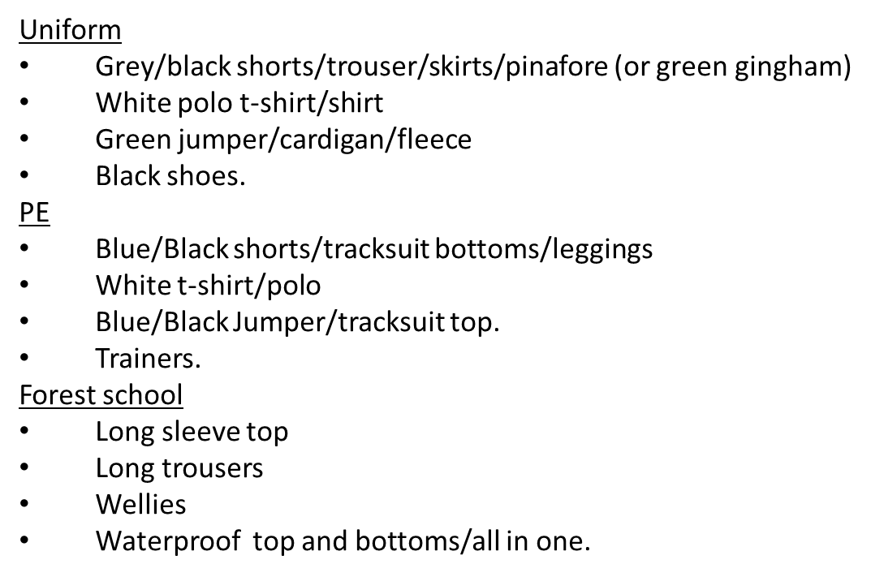
Uniform Expectations

Slide 11
PE and Forest School
P.E and Forest School
Monday
Kingfishers, Falcons and Wolves – P.E and Forest school
Thursday
Kingfishers and Wolves – P.E
Friday
Falcons- PE
PE-
Mrs Stone
Art/Spanish-
Miss Mejias-Panilla
Forest school –
Miss Hall-Lindop

Slide 12
Homework
Children will have their spelling test on a Friday.
Use TTRS to practice Times tables- compete for the ROCK OUT party!
A topic-based piece of homework for children to undertake. Children will be given the choice of six different tasks. They choose one or two of those and complete the task, bringing in their homework at the end of term.
All homework will be posted on the school website.
The Academy of Woodlands - Homework

Slide 13
Reading
Now your child is in Upper Key Stage 2, we will have a stronger focus on reading comprehension.
Children will complete an AR test in school once their book is complete.
Please sign their contact book each time you read with them. Putting which pages they have read and whether they have finished their book is particularly helpful.
There is no need to read a whole book every night. In fact, it is probably more useful to just read a few pages and spend time discussing what has been read and asking questions to check for understanding.

Slide 14
Purple Mash
This is the site the whole school will be using to support the children’s computing lessons.
Tasks related to their class work may be set as "To Do's" to complement their learning.

Slide 15
Before and After School Provision
Before school – Entry Via the Arts Centre
WASPs (Paid for breakfast provision.) 7:30am - 8:35am (Children taken to classrooms)
Free Breakfast club – 8:00am -8:35am (Children taken to classrooms)
After School
Clubs- have limited spaces. 3:20pm – 4:20pm collection from allocated place.
WASPs (Paid for afterschool provision.) from 3:20pm – 6:00pm- collection form Arts centre.
More information about WASPs can be found on the school website under the ‘Wrap Around Care’ section.
The Academy of Woodlands - How To Book

Slide 16
Any Questions?
Please feel free to ask any questions you may have.

