Slide 1

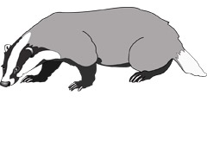


Meet the Teacher
Year 4
Badgers – Mr Graham & Mrs Costidell
Butterflies – Mrs Hyslop, Mrs Woolmer & Mrs Carroll
Beetles - Mrs Field and Mrs McCandless
Phase Lead- Mrs Hyslop

Slide 2
New Start and Finish Times
8:35am – gates and classrooms open. (Registration closes at 8:55am)
3:10pm – pick up time.
4:20pm – club finish time.

Slide 3
Curriculum Overview
Term 1:
English – Charlie & The Chocolate Factory
Maths – Place value and addition and subtraction
Science – Grouping Living Things
History – Ancient Greece
ICT – Coding
P.E – Basketball and hockey
PSHE – British values/School Values
D.T – Rice Crispy cakes
Spanish – Introducing and describing yourself.

Slide 4
Curriculum Overview
Term 2:
English – Leo and the Gorgons Curse
Maths –Area and Multiplication and Division
Science – States of Matter
History – Ancient Greece
ICT – Hardware Investigators and Making Music
P.E – Badminton and indoor athletics
R.E – Christianity
PSHE – Keeping safe
Art – Greek mythological creatures self portrait
Spanish – Nationality and language

Slide 5
Curriculum Overview
Term 3:
English – The Lion, the Witch and the Wardrobe
Maths – Multiplication and division, Length and Perimeter and Fractions
Science – Sound
Geography – Ancient Rome
ICT – Online safety and Effective searching
P.E – Dance and Tag Rugby
R.E – Buddism/Judaism
PSHE – Eat well, live well
Art – Roman Mosaics
Spanish – Describing pets, colours and animals

Slide 6
Curriculum Overview
Term 4:
English – Escape from Pompeii
Maths – Fractions and Decimals
Science – Electricity
Geography – Romans in Britain
ICT – Writing for Different Audiences
P.E – Gymnastics and Netball
R.E – Christianity
PSHE – Our wonderful world
Art – Roman Pottery
Spanish – Clothing

Slide 7
Curriculum Overview
Term 5:
English – The Great Kapok Tree
Maths – Decimals, Money and Time
Science – Habitats
Geography – Rainforests
ICT – Spreadsheets
P.E – Kwik Cricket and Athletics
R.E – Buddhism/Judaism
PSHE – Money Matters
Art – Rainforest animals inspired art
Spanish – Parts of the head, face and body

Slide 8
Curriculum Overview
Term 6:
English – Street Child
Maths – Shape, Statistics, Position and Direction
Science – The Digestive System
Geography – Rivers and Coasts
ICT – Logo and Animation
P.E – Football and Rounders
R.E – Christianity
PSHE – Transition and moving up
Art – Claude Monet inspired river art
Spanish – Food

Slide 9
P.E and Forest School
Badgers Term 1
PE – Tuesday & Thursday
Forest School - Tuesday
Beetles Term 1
PE – Tuesday & Thursday
Forest School- Tuesday
Butterflies Term 1
PE – Tuesday & Friday (swimming)
Forest School- Tuesday

Slide 10
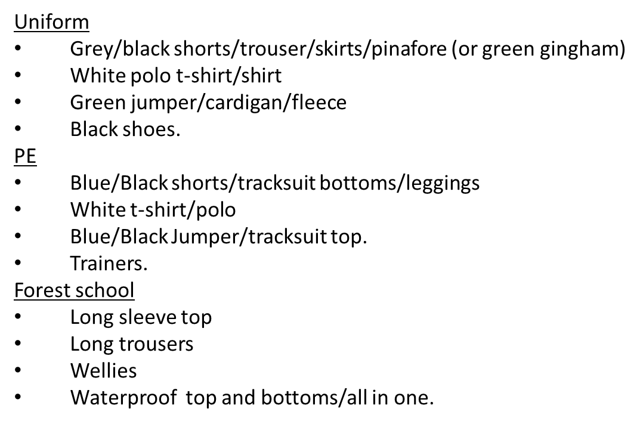
Uniform Expectations

Slide 11
MTC
MTC stands for Multiplication Tables Check.
This is a national test which all children in Year 4, throughout the country, will sit in June.
It will be taken on a computer.
It will focus on their recall of their times tables only and not division.
Children have 25 questions and 6 seconds to answer each one.
MTC information video

Slide 12
Reading
Now your child is in their second year of being in KS2, we will have a stronger focus on reading comprehension.
Children still need to read as much as they can at home.
Please sign their contact book each time you read with them. Putting which pages they have read and whether they have finished their book is particularly helpful.
There is no need to read a whole book every night. In fact it is probably more useful to just read a few pages and spend time discussing what has been read and asking questions to check for understanding.

Slide 13
Purple Mash
Your child will have already brought home a login for the Purple Mash website. This is the site the whole school will be using to support the children’s ICT lessons.
There are a couple of multiplication games on this site which would be really useful practise for the MTC, as well as lots of other games and activities which will support the children’s learning in different areas.
Teachers will set tasks for the children to complete at home and whilst these are not compulsory, they will be supporting your child’s work in class.

Slide 14
Before and After School Provision
Before school – Entry Via the Arts Centre
WASPs (Paid for breakfast provision.) 7:30am - 8:40am (Children taken to classrooms)
Free Breakfast club – 8:00am -8:40am (Children taken to classrooms)
After School
Clubs- have limited spaces. 3:20pm – 4:20pm collection from allocated place.
WASPs (Paid for afterschool provision.) from 3:20pm – 6:30pm- collection form Arts centre.
More information about WASPs can be found on the school website under the ‘Wrap Around Care’ section.
https://www.theacademyofwoodlands.co.uk/page/?title=How+To+Book&pid=88

Slide 15
In March some of the children from Year 4 will be given the opportunity to attend the Medway Music Festival.
This is an exciting opportunity for the children to perform on stage, with other schools. Nearer the time we will be asking which children would like to attend as the number of places is restricted to 45.
Medway Music Festival

Slide 16
Questions?

