Slide 1

Meet the Teacher
Year 3
Dragonflies – Miss Pound & Miss Smirthwaite
Dormice- Miss Whatley & Ms Gravenell
Foxes- Mr. Slack & Miss Murtagh
Notes:
Introduce ourselves

Slide 2
Start and Finish Times
8:35am – gates and classrooms open. (Registration closed at 8:55am)
3:10pm – pick up time.
4:20pm – club finish time.
Notes:
Connor

Slide 3
Curriculum Overview – Term 1
English – George’s Marvellous Medicine
Maths – Place Value/Addition & Subtraction
Science – Animals including humans (Skeletons)
History – Stone age into Iron Age
RE – What makes us Human?
PSHE – Family, Kindness and Respect
PE – Basketball & Hockey
Music – Harvest Festival song
Computing - Coding
MFL – Spanish Greetings
DT – Mechanical Systems
Notes:
Connor

Slide 4
Curriculum Overview – Term 2
English – The Thames and tide club
Maths – Addition, Subtraction, Multiplication & Division
Science – Nutrition & Diet
Geography - Europe
RE – Where do our morals come from?
PSHE – Helps, Laws and Human Rights
PE – Dance & Tag Rugby
Music – Charanga - Glockenspiels
Computing – Online Safety & Simulations
MFL – Spanish Numbers & Ages
DT – Cooking & Nutrition
Notes:
Connor

Slide 5
Curriculum Overview – Term 3
English – Mummy ate my Homework
Maths – Multiplication & Division, Length and Perimeter
Science – Rocks, fossils and soils
History – Egyptians
RE – Is scripture central to Religion?
PSHE –
PE – OAA & Dodgeball
Music – Charanga – Three Little Birds
Computing – Spreadsheets
MFL – Shapes and Colours
Art – Sculptures & Masks – Julian Crouche
Notes:
Asha

Slide 6
Curriculum Overview – Term 4
English – Mummy ate my homework
Maths – Fractions, Mass & Capacity
Science – Light
Geography - Egypt
RE – What happens if we do wrong?
PSHE – Fires & Safety
PE – Gymnastics & Netball
Music – Charanga – The Dragon Song
Computing – Touch Typing & Graphing
MFL – Classroom Objects
Art – Line Drawings – Da Vinci
Notes:
Asha

Slide 7
Curriculum Overview – Term 5
English – Firework Maker’s Daughter
Maths – Fractions, Money & Time
Science – Plants
Geography – Volcanoes and Earthquakes
RE – Why is water Symbolic?
PSHE – Balanced Lifestyles
PE – Athletics & Cricket
Music – Bringing Us Together
Computing - Email
MFL – Where do you live?
DT – Earthquake proof buildings
Notes:
Shannon

Slide 8
Curriculum Overview – Term 6
English – When the mountains roared
Maths – Time, Shape & Statistics
Science – Forces & Magnets
Geography – Mountains
RE – Why is fire used ceremonially?
PSHE – Health & Media
PE – Rounders & Football
Music – Charanga – Reflect, Rewind and Replay
Computing - Presenting
MFL – Journey around Latin America
Art – Printing - Hokusai
Notes:
Shannon

Slide 9
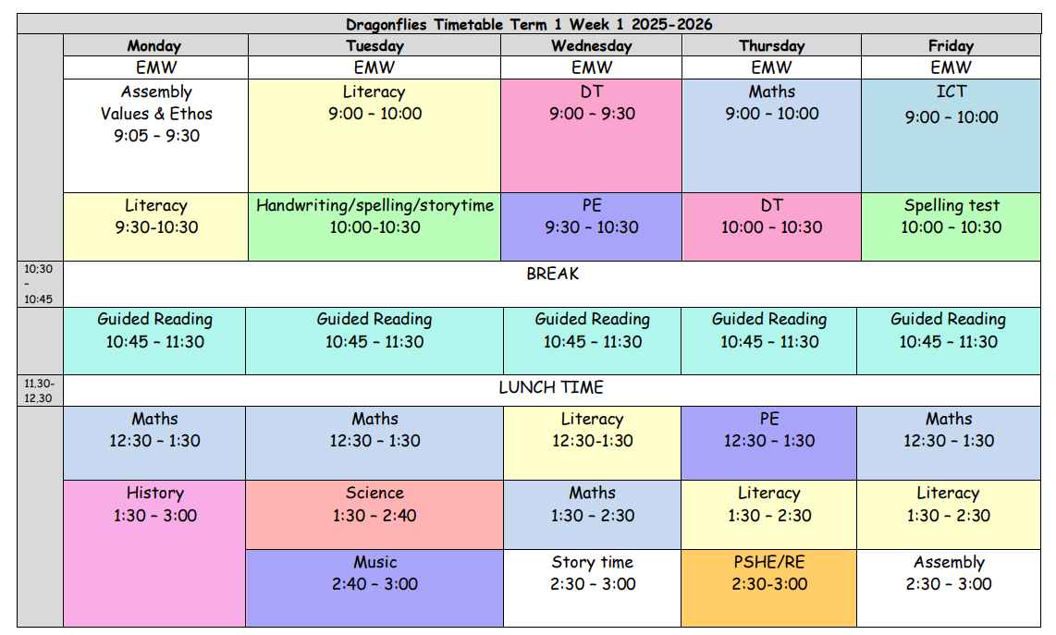
Year 3 Timetable Example
Notes:
Asha

Slide 10
Class Timetable
PE Days – Wednesdays and Thursdays
Forest School Dates (Term 1)
Wednesday 1st October
Wednesday 15th October
Notes:
Asha

Slide 11
Forest School Dates
(Terms 2 & 3)
Wednesday 12th November
Wednesday 26th November
Wednesday 10th December
Wednesday 7th January
Wednesday 21st January
Wednesday 4th February
Notes:
Asha

Slide 12
Uniform Expectations
Uniform
Grey/black shorts/trouser/skirts/pinafore (or green gingham)
White polo t-shirt/shirt
Green jumper/cardigan/fleece
Black shoes.
PE
Blue/Black shorts/tracksuit bottoms/leggings
White t-shirt/polo
Blue/Black Jumper/tracksuit top.
Trainers.
Forest school
Long sleeve top
Long trousers
Wellies
Waterproof top and bottoms/all in one.
Notes:
Shannon

Slide 13
Additional Staff
PE Team
Mrs Stone
Forest School
Miss Hall-Lindop
Support staff and PPA teachers
Mrs. Ward
Mrs. Bonney
Miss Mejias (Art & Spanish)
Notes:
Connor

Slide 14
Before and After School Provision
Before school – Entry Via the Arts Centre
WASPs (Paid for breakfast provision.) 7:30am - 8:40am (Children taken to classrooms)
Free Breakfast club – 8:00am -8:40am (Children taken to classrooms)
After School
Clubs- have limited spaces. 3:20pm – 4:20pm collection from allocated place.
WASPs (Paid for afterschool provision.) from 3:20pm – 6:30pm- collection form Arts centre.
More information about WASPs can be found on the school website under the ‘Wrap Around Care’ section.
https://www.theacademyofwoodlands.co.uk/page/?title=How+To+Book&pid=88
Notes:
Connor

Slide 15
Questions

