Slide 1

Meet the Teacher
Year 1
Mrs Johnson & Mrs Parr
Miss Sutton & Miss Willson
Mrs Murphy & Mrs Cripps

Slide 2
New Start and Finish Times
8:40am – gates and classrooms open. (Registration closed at 8:55am)
3:10pm – pick up time.
4:20pm – club finish time.

Slide 3
Daily Overview
Each day consists of:
RWI and Maths in am
Breaks at 10.10-10.25am and Lunch 11:30-12:30
Other subjects in pm: Science, History/Geography, PE, Forest school, ICT, RE / PSHE, Music
Continuous provision throughout the three classrooms in the pm.

Slide 4
Class Timetable
Caterpillars: PE on Monday & Thursday
Squirrels: Pe on Monday pm and Thursday am
Robins: PE on Tuesday & Friday

Slide 5
Curriculum Overview
Maths: place value, + & -, shape, measures, x & ÷, fractions, position and direction, money and time
Science: animals including humans, seasons and weather, materials and plants.
History/Geography: Where do I live? My History, Mammals, Toys – then and now, Oceans and Seas, Explorers

Slide 6
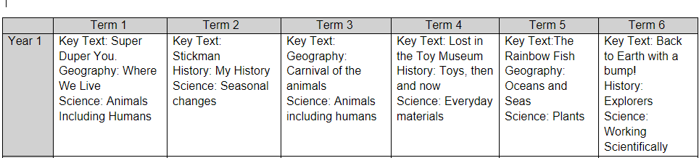
Creation

Slide 7
Uniform Expectations
Uniform
Grey/black shorts/trouser/skirts/pinafore (or green gingham)
White polo t-shirt/shirt
Green jumper/cardigan/fleece
Black shoes.
PE
Blue/Black shorts/tracksuit bottoms/leggings
White t-shirt/polo
Blue/Black Jumper/tracksuit top.
Trainers. **Please remove earrings and jewellery on this day**
Hair must be tied up.
Forest school
Long sleeve top
Long trousers
Wellies
Waterproof top and bottoms/all in one.

Slide 8
Additional Staff
PE Team
Mr Collins
Mrs Stone
Forest School
Mrs Mortimer
Support staff and PPA teachers
Mrs Davies, Miss Bonney and Mrs Ward

Slide 9
Homework Expectations
When homework begins, it will be put on the school website each week.
Homework books will be sent home on a Tuesday and homework to be handed in the following Monday.
It does not need to be printed out, just write answers in books.

Slide 10
Before and After School Provision
Before school – Entry Via the Arts Centre
WASPs (Paid for breakfast provision.) 7:30am - 8:40am (Children taken to classrooms)
Free Breakfast club – 8:00am -8:40am (Children taken to classrooms)
After School
Clubs- have limited spaces. 3:20pm – 4:20pm collection from allocated place.
WASPs (Paid for afterschool provision.) from 3:20pm – 6:30pm- collection form Arts centre.
More information about WASPs can be found on the school website under the ‘Wrap Around Care’ section.
https://www.theacademyofwoodlands.co.uk/page/?title=How+To+Book&pid=88

Slide 11
Questions

