Slide 1
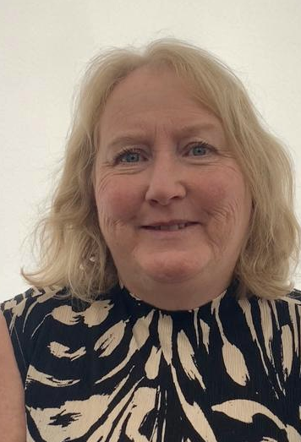

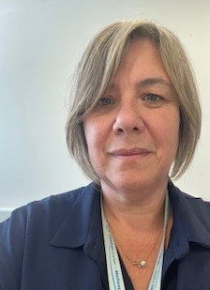
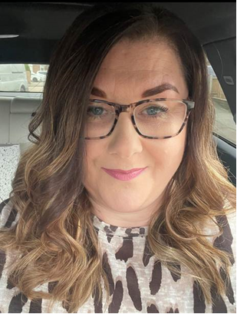
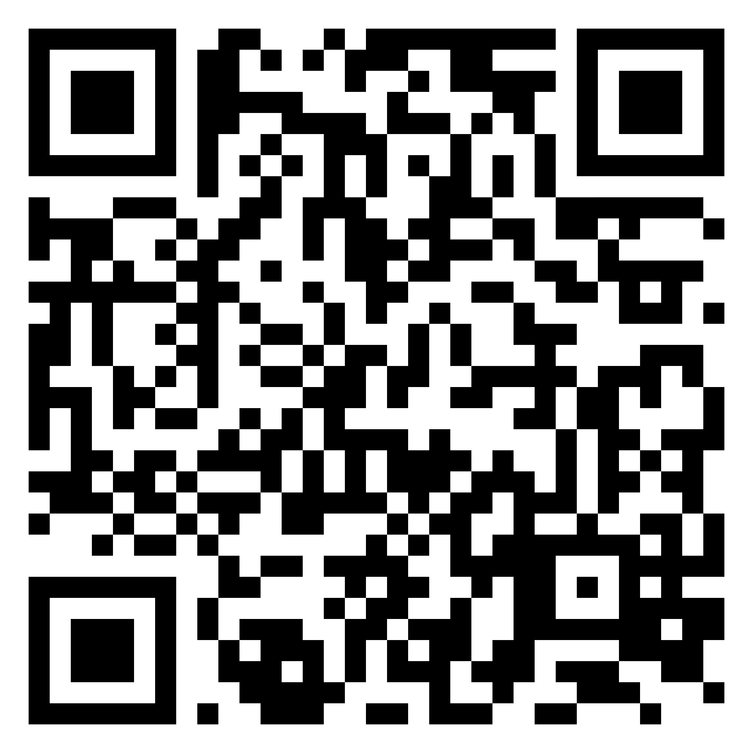
Family Solutions, Early Help
Meet the Team
If you see us come and talk to us, if you have any enquiries, please call or
e-mail us!
Contact us today to see how we can support you and the work you do with families.
Gillingham Children and Family Hub:
01634 338877
Carol Lee
Gillingham Children & Family Hub Manager
carol.lee@medway.gov.uk
Helen Laming
Early Help Co-Ordinator Area 1
helen.laming@medway.gov.uk
Mobile: 07970 334074
Download the Medway Family Hub App: www.MedwayFamilyHub.co.uk
Debbie Klucznik
Early Help Partnership Officer Area 1
debbie.klucznik@medway.gov.uk
Mobile: 07712 697127

